Slide 1
SDLC AND SWOT ANALYSIS
Course Supervisor: Syeda Nazia Ashraf

Slide 2
Software Development Life Cycle

Slide 3
SDLC….What?
Software Development Life Cycle (SDLC) is a process used by the software industry to design, develop and test high quality softwares. The SDLC aims to produce a high-quality software that meets or exceeds customer expectations, reaches completion within times and cost estimates.
SDLC is the acronym of Software Development Life Cycle.
It is also called as Software Development Process.
SDLC is a framework defining tasks performed at each step in the software development process.
ISO/IEC 12207 is an international standard for software life-cycle processes. It aims to be the standard that defines all the tasks required for developing and maintaining software.

Slide 4
Details of SDLC
SDLC is a process followed for a software project, within a software organization. It consists of a detailed plan describing how to develop, maintain, replace and alter or enhance specific software. The life cycle defines a methodology for improving the quality of software and the overall development process.

Slide 5
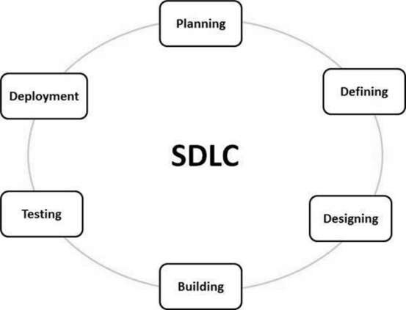
Typical stages

Slide 6
Planning and Requirement Analysis
Stage 1: Planning and Requirement Analysis
Requirement analysis is the most important and fundamental stage in SDLC. It is performed by the senior members of the team with inputs from the customer, the sales department, market surveys and domain experts in the industry. This information is then used to plan the basic project approach and to conduct product feasibility study in the economical, operational and technical areas.
Planning for the quality assurance requirements and identification of the risks associated with the project is also done in the planning stage. The outcome of the technical feasibility study is to define the various technical approaches that can be followed to implement the project successfully with minimum risks.

Slide 7
Defining Requirements
Stage 2: Defining Requirements
Once the requirement analysis is done the next step is to clearly define and document the product requirements and get them approved from the customer or the market analysts. This is done through an SRS (Software Requirement Specification) document which consists of all the product requirements to be designed and developed during the project life cycle.

Slide 8
Designing the Product Architecture
Stage 3: Designing the Product Architecture
SRS is the reference for product architects to come out with the best architecture for the product to be developed. Based on the requirements specified in SRS, usually more than one design approach for the product architecture is proposed and documented in a DDS - Design Document Specification.
This DDS is reviewed by all the important stakeholders and based on various parameters as risk assessment, product robustness, design modularity, budget and time constraints, the best design approach is selected for the product.
A design approach clearly defines all the architectural modules of the product along with its communication and data flow representation with the external and third party modules (if any). The internal design of all the modules of the proposed architecture should be clearly defined with the minutest of the details in DDS.

Slide 9
Building or Developing the Product
Stage 4: Building or Developing the Product
In this stage of SDLC the actual development starts and the product is built. The programming code is generated as per DDS during this stage. If the design is performed in a detailed and organized manner, code generation can be accomplished without much hassle.
Developers must follow the coding guidelines defined by their organization and programming tools like compilers, interpreters, debuggers, etc. are used to generate the code. Different high level programming languages such as C, C++, Pascal, Java and PHP are used for coding. The programming language is chosen with respect to the type of software being developed.

Slide 10
Testing the Product
Stage 5: Testing the Product
This stage is usually a subset of all the stages as in the modern SDLC models, the testing activities are mostly involved in all the stages of SDLC. However, this stage refers to the testing only stage of the product where product defects are reported, tracked, fixed and retested, until the product reaches the quality standards defined in the SRS.

Slide 11
Deployment in the Market and Maintenance
Stage 6: Deployment in the Market and Maintenance
Once the product is tested and ready to be deployed it is released formally in the appropriate market. Sometimes product deployment happens in stages as per the business strategy of that organization. The product may first be released in a limited segment and tested in the real business environment (UAT- User acceptance testing).
Then based on the feedback, the product may be released as it is or with suggested enhancements in the targeting market segment. After the product is released in the market, its maintenance is done for the existing customer base.

Slide 12
SDLC Models
There are various software development life cycle models defined and designed which are followed during the software development process. These models are also referred as "Software Development Process Models". Each process model follows a Series of steps unique to its type to ensure success in the process of software development.

Slide 13
What is SWOT Analysis?
SWOT analysis is the technique used for Strategic Planning and Analysis.
Helps to identify the Strengths, Weaknesses, Opportunities, and Threats.
Related to Business competition and Project Planning.
It is a framework used to evaluate a company's competitive position
Helps to specify the objectives of a Business Venture or Project and identify the internal and external factors that are favorable or unfavorable to achieve these objectives.

Slide 14
Why we use SWOT Analysis?
It is used to explore new solutions to problems.
To identify the barriers that limits goals and objectives.
Helps to decide a direction that will be most effective.
Helps to reveal possibilities and limitations for change.
To revise plans to best navigate systems, communities and organizations.
Act as a brainstorming device.

Slide 15
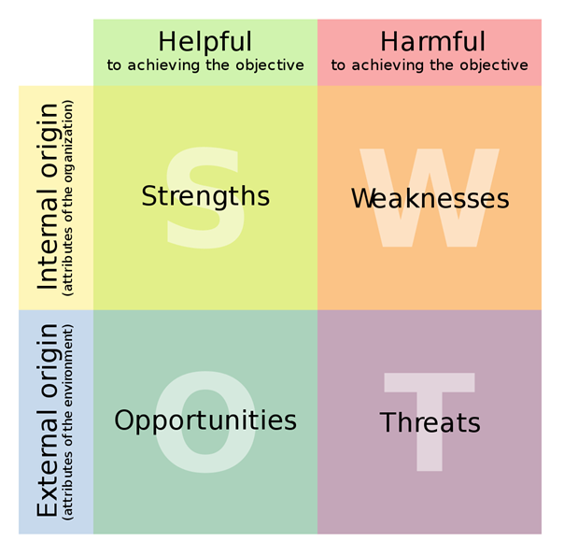
SWOT Matrix

Slide 16
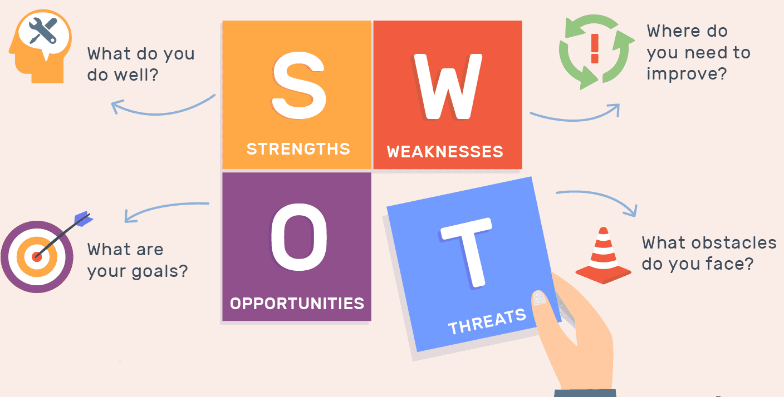

Slide 17
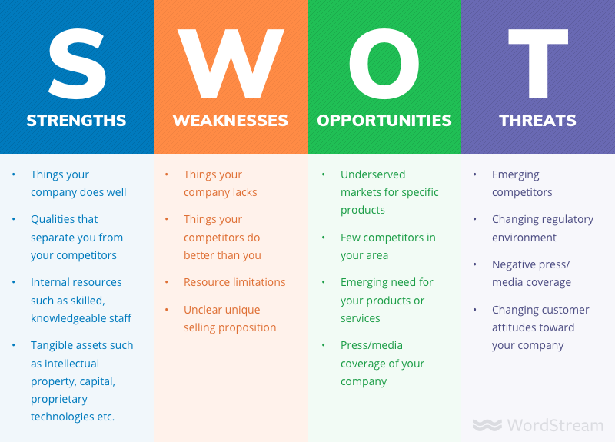

Slide 18
SWOT Analysis (Strengths, Weaknesses, Opportunities and Threats analysis)
SWOT analysis is a framework for identifying and analyzing an organization's strengths, weaknesses, opportunities and threats -- which is what makes up the SWOT acronym. The primary goal of SWOT analysis is to aid organizations in increasing awareness of the factors in making a business decision. SWOT accomplishes this by analyzing the internal and external factors that can impact the viability of a decision.
SWOT analysis is most commonly used by business entities, but it is also used by nonprofit organizations and, to a lesser degree, individuals for personal assessment. Additionally, it can be used to assess initiatives, products or projects. The framework is credited to Albert Humphrey, who tested the approach in the 1960s and 1970s at the Stanford Research Institute. Developed for business and based on data from Fortune 500 companies, the SWOT analysis has been adopted by organizations of all types as an aid to making decisions.

Slide 19
When and Why you should do a SWOT Analysis
SWOT analysis is often used either at the start of, or as part of, a strategic planning exercise. The framework is considered a powerful support for decision-making because it enables an organization to uncover opportunities for success that were previously unarticulated and highlights threats before they become overly burdensome.
As an example, this exercise can identify a market niche in which a business has a competitive advantage. It can also help individuals plot career success by pinpointing a path that maximizes their strengths while alerting them to threats that can thwart achievement.

Slide 20
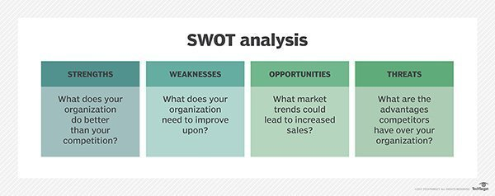
SWOT Analysis

Slide 21
Elements of a SWOT analysis
Strengths: Internal attributes and resources that support a successful outcome.
Weaknesses: Internal attributes and resources that work against a successful outcome.
Opportunities: External factors that the entity can capitalize on or use to its advantage.
Threats: External factors that could jeopardize the entity's success.

Slide 22
How to write a good SWOT analysis
Writing a good SWOT analysis starts with brainstorming, or brain-writing. Get your team together in a room with a whiteboard, and start coming with strengths, weaknesses, opportunities, and threats.​

Slide 23
A QUICK GLANCE
Strengths: What is your team really good at? What do you offer people that others can’t or don’t?
Weaknesses: What are some things that your team is not very good at, that others do much better?
Opportunities: What are some areas that your organization could thrive in that it isn’t currently taking advantage of?
Threats: What are some external factors—competitors, consumer demand, economic conditions—that could make it more difficult for your team to succeed?

Slide 24
How to do a SWOT analysis
A SWOT analysis generally requires decision-makers to first specify the objective they hope to achieve for the business, organization, initiative or individual.
From there, the decision-makers list the strengths and weaknesses as well as opportunities and threats.
Various tools exist to guide decision-makers through the process, often using a series of questions under each of the four elements. For example, decision-makers may be guided through questions such as "What do you do better than anyone else?" and "What advantages do you have?" to identify strengths; they may be asked "Where do you need improvement?" to identify weaknesses. Similarly, they'd run through questions such as "What market trends could increase sales?" and "Where do your competitors have market advantages?" to identify opportunities and threats.
The end result of a SWOT analysis should be a chart or list of a subject's characteristics.

Slide 25
Example of a SWOT analysis
Imaginary Retail Employee:
Strengths: good communication skills, on time for shifts, handles customers well, gets along well with all departments, physical strength, good availability.
Weaknesses: takes lengthy smoke breaks, low technical skill, very prone to spending time chatting.
Opportunities: storefront worker, greeting customers and assisting them to find products, helping keep customers satisfied, assisting customers post-purchase with items and ensuring buying confidence, stocking shelves.
Threats: occasionally missing time during peak business due to breaks, sometimes too much time spent per customer post-sale, too much time in interdepartmental chat.

Slide 26
Using a SWOT analysis
A SWOT analysis should be used to help an entity, whether it is an organization or an individual, to gain insight into its current and future position in the marketplace or against a stated goal.
The idea is that because entities can see competitive advantages, positive prospects as well as existing and potential problems, they can develop plans to capitalize on positives and address deficiencies.
In other words, once the SWOT factors are identified, decision-makers should be better able to ascertain if an initiative, project or product is worth pursuing and what is needed to make it successful. As such, the analysis aims to help an organization match its resources to the competitive operational environment.

Slide 27
5 SWOT analysis examples - Banana for breakfast

Slide 28
Weekend trip to the lake

Slide 29
Jog after work

Slide 30

Free or open source project management software

Slide 31
Hiring a summer intern

Slide 32
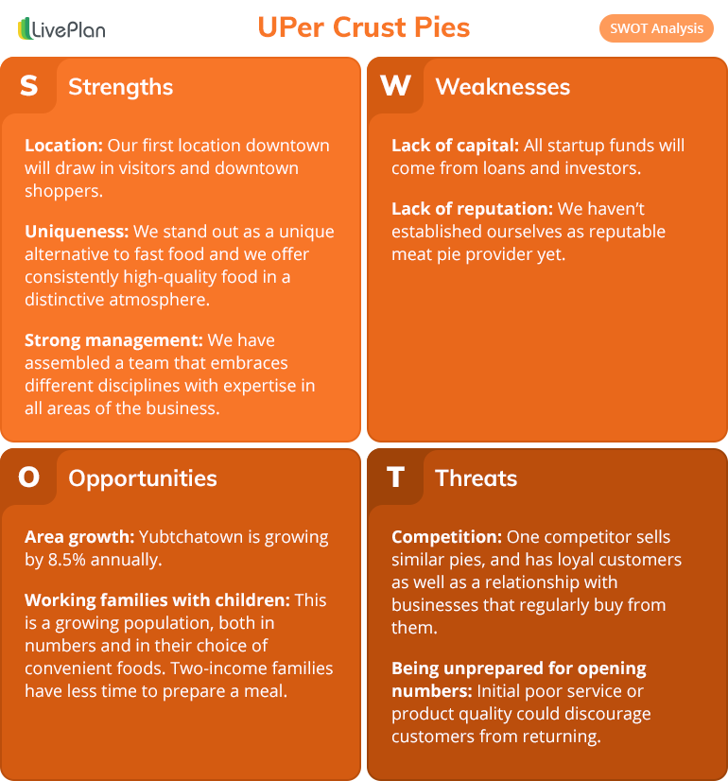
Example

Slide 33
Example: Digital Marketing Agency
Strengths
Weaknesses
Opportunities
Threats
Will established position within a well-defined niche.
Identified market for projects using traditional marketing.
Larger agencies using less-experienced consultants.
Smaller agencies seeking to enter that market.
Reputation in a marketplace.
High level of expertise in the Agency
Shortage of experienced consultants available.
Unable to handle too many projects at a time because of shortage of resources they had their expertise.

